Slide 1
Multi-Cloud and Hybrid Cloud Strategies for IT Enterprise
CSA1513 Cloud computing and big data analytics
Vijayalakshmi G
192321080
B.Tech IT

Slide 2
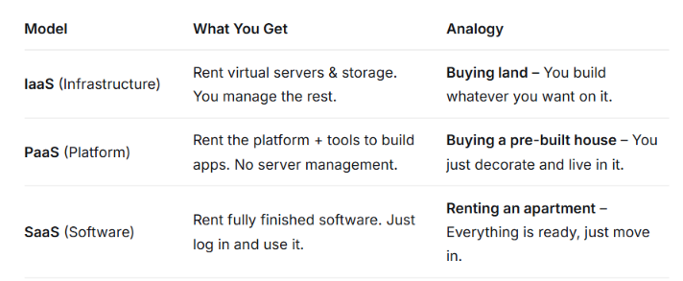
What is Cloud computing?
Cloud computing is renting computing resources (servers, storage, databases, software) over the internet instead of buying and maintaining your own physical hardware.

Slide 3
Cloud Models
Hybrid Cloud
What it is: A combination of a private cloud and a public cloud used together.
Goal: To share and manage data and applications between both cloud environments easily.
Multi-Cloud
What it is: Using cloud services from multiple cloud providers like AWS, Azure, or Google Cloud.
Goal: To choose different cloud providers based on the services and features needed.

Slide 4
The Hybrid Cloud
Hybrid Cloud
A Hybrid Cloud combines a private cloud or local infrastructure with public cloud services.
Examples:
A bank keeps customer financial data in a private cloud but uses the public cloud to run its website.
A company uses the public cloud to train an AI model and then moves it to its private system for better security.

Slide 5
Hybrid Cloud – Benefits & Challenges
Benefits | Challenges
Keep sensitive data secure on-premises | Complex integration between environments
Burst to public cloud during demand spikes | High upfront hardware costs
Modernize legacy systems gradually | Hard to monitor across two environments
Low latency for critical workloads | Risk of vendor lock-in with proprietary tools

Slide 6
The Multi-Cloud Strategy
Multi-Cloud
A Multi-Cloud strategy uses cloud services from two or more public cloud providers.
Flexibility and Choice – Each cloud provider is chosen based on the services and features it offers.
Examples:
An online shopping company uses Microsoft Azure for its online store and Google Cloud for AI-based recommendations.
A company uses AWS for its main applications and Microsoft Azure for Microsoft tools and user management.

Slide 7
Multi-Cloud – Benefits & Challenges
Benefits | Challenges
Avoid vendor lock-in completely | Managing multiple clouds is operationally complex
Choose best-in-class services per need | Cost tracking across providers is difficult
Superior disaster recovery & redundancy | Inconsistent security policies across clouds
Optimize costs by comparing provider pricing | High data egress fees between clouds

Slide 8
Conclusion & Recommendations
Choose Hybrid Cloud if:
You have old systems that cannot be moved to the cloud immediately.
You need high security and follow strict rules, especially in finance, healthcare, or government.
You want to move to the cloud step by step without affecting your current operations.
Choose Multi-Cloud if:
You want to avoid depending on one cloud provider.
You need different cloud services for different purposes, such as AI and data analysis.
You need services in different locations to improve availability and reliability.

Slide 9
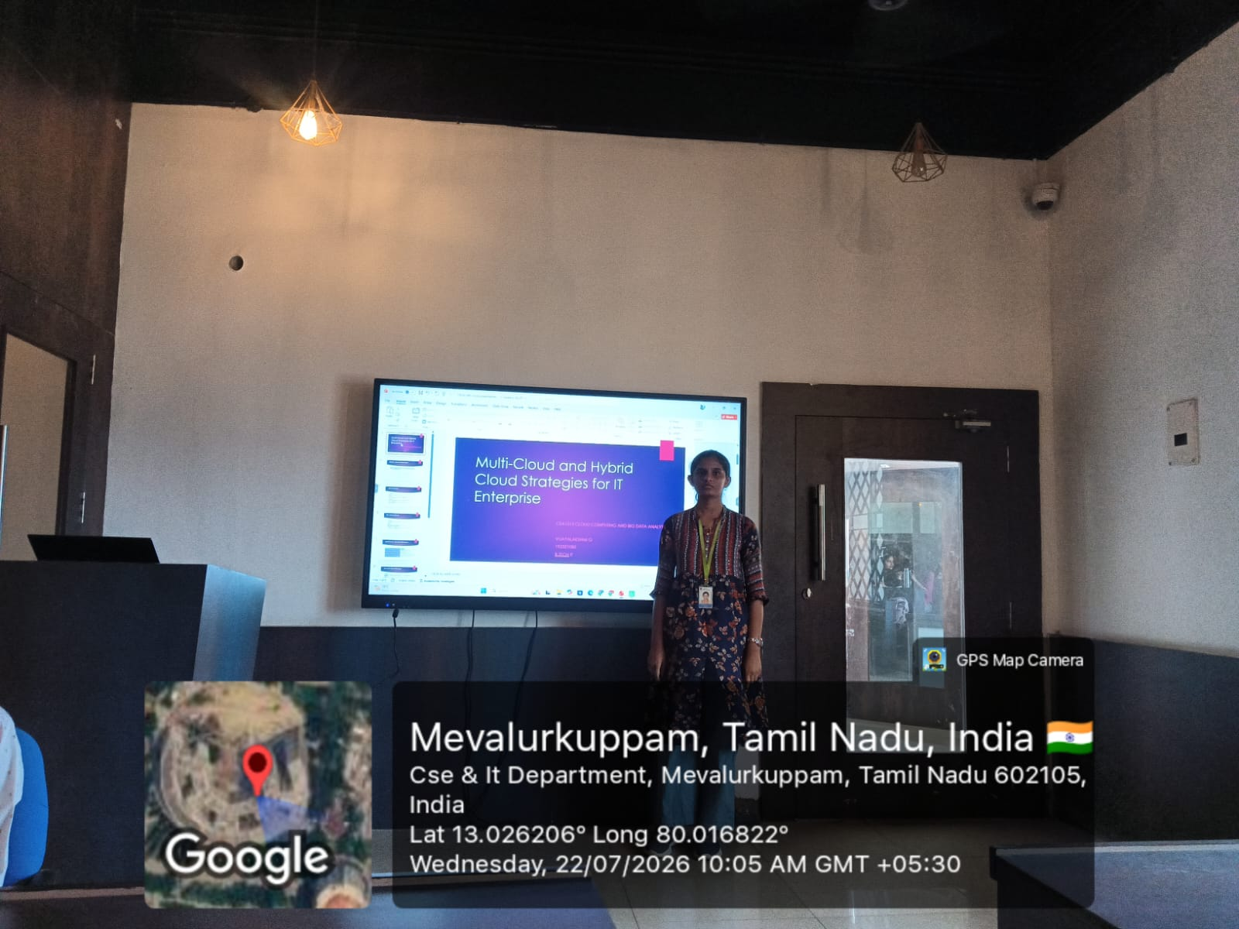
Geotagging photo

Slide 10
Thank you

